Slide 1
Using Ant

Slide 2
Objectives
XML basics
Introduction to Ant build tool

Slide 3
XML

Slide 4
XML Basics
XML (eXtensible Markup Language)
Text files
Hierarchical
Composed of tags similar to HTML tags
  HTML 4.0 is a dialect of XML
In XML, you can invent your own tags

Slide 5
XML Tag Syntax
The content of an XML document is structured by means of tags
All tags must have an opening and closing delimiter
Tags can be nested to achieve the tree structure
  <tagName> content </tagName>

Slide 6
XML Tag Syntax (cont’d)
Tags can have attributes
  <tagName attribute="value">
  content
  </tagName>
Some tags are self-contained
  <tagName attribute="value"/>

Slide 7
XML Tag Syntax (cont’d)
Tags can be nested – tags can form the content of other tags
  <tagName attribute="value">
  <nestedTag attribute="value"/>
  </tagName>

Slide 8
Ant

Slide 9
Introduction to Ant
Ant:
  Is a build tool written in Java
  Uses an XML build file language
  Runs on any platform Java runs
  Was designed to build and deploy Java applications
  Has native support for routine Java tasks: java compilation, running Junit tests, creating JavaDocs

Slide 10
Introduction to Ant (cont’d)
Ant is not:
  An XML scripting language
  A replacement for make
    Make works well for C/C++ development and many other tasks, but is cumbersome and inefficient for Java
    Ant knows nothing about C/C++ compilers, include files, etc.

Slide 11
Origin of Ant
Created by James Duncan Davidson in 1998
Created to build and deploy Java Servlet 2.1 reference implementation (Tomcat) on Solaris, Windows, MacOS and Linux
Needed a build tool that worked identically on all platforms

Slide 12
Ant Artifacts
build.xml
ant build.xml
SomeClass.java
foo.txt
SomeClass.class
FunnyCatImage.jpg
MyApplication.jar
...

Slide 13
Using Ant
Key Concepts
  Project: One per build file
  Properties: Simple name value pairs
  Targets: A step that (usually) generates artifacts
  Tasks: Individual steps that are part of a target
  Filesets: File selection specifications

Slide 14
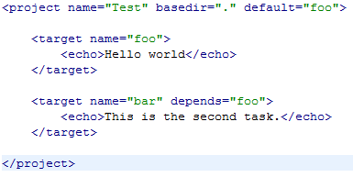
Ant Projects
The Project
  Root element of the build.xml
  One project per build.xml
  The project tag surrounds all other elements

Slide 15
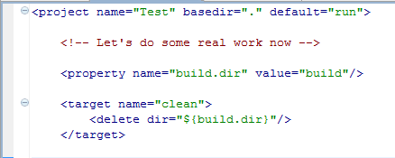
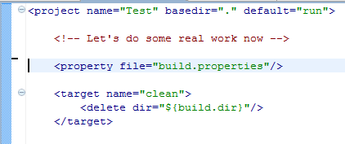
property
Definition:
  Can be defined inline using name and value, or
  Can be defined in a file and loaded with file
Expansion
  "${<property_name>}"

Slide 16
Ant Targets
Usually:
  The sets of artifacts ant must create, e.g. a jar file, or
  Steps that must occur as part of the build, e.g. running unit tests
Each project has a default target
Targets can depend on each other
Examples:
  compile
  build
  clean
You define your own

Slide 17
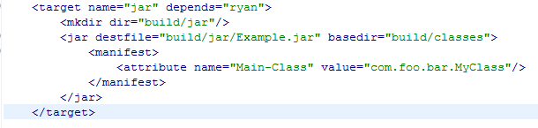
Ant Tasks
Smallest building blocks of Ant
Define operations performed by a target
  Perform the actual work
  All operations are wrapped in tasks
Many tasks are provided by Ant
You can create your own
Notes:
After this slide, open Eclipse and:
Walk through the anatomy of several build files
Show how to run ant from the command line

Slide 18
Running Ant
ant [option [option…]] [target [target…]]
  If target is not specified the default target is built
most used options:
  -help
  -projecthelp
  -version
  -quiet | verbose
  -buildfile filename (defaults to build.xml)
  -f filename
  -Dproperty=value

Slide 19
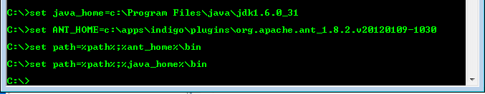
Setting Up Ant
Administrative Detail:
  You need to set JAVA_HOME, ANT_HOME, and update your PATH to include both of these plus the \bin subdirectory
  On Windows:

Slide 20
project
Attributes
  name, project name
  default, the default target (required)
  basedir, base directory for path calculations ‘.’ by default
<?xml version="1.0"?>
<!-- ===================================================================== -->
<!-- Build file for 'JBoss Test'. -->
<!-- ===================================================================== -->
<project name="JBossTest" default="default" basedir=".">
.
.
.
</project>

Slide 21
target
Attributes
  name, target name (required)
  depends, targets this target depends on
<!-- ================================================================== -->
<!-- Makes sure the needed directory structure is in place -->
<!-- ================================================================== -->
<target name="prepare" depends="init">
<mkdir dir="${build.dir}"/>
<mkdir dir="${lib.dir}"/>
</target>

Slide 22
Tasks
Tasks of particular interest
  mkdir
  copy
  delete
  javac
  jar
  ant
  antcall

Slide 23
mkdir
Attributes
  dir, directory to create (required)
<!-- ================================================================== -->
<!-- Makes sure the needed directory structure is in place -->
<!-- ================================================================== -->
<target name="prepare" depends="init">
<mkdir dir="${build.dir}"/>
<mkdir dir="${lib.dir}"/>
</target>

Slide 24
copy
Attributes
  file, file to copy (required, or nested fileset)
  tofile, destination (required, or tofile)
  todir, destination (required, or todir)
Nested Elements
  fileset
<!-- ================================================================== -->
<!-- Deploy the ear file -->
<!-- ================================================================== -->
<target name="deploy" depends="ear,client">
<copy file="${build.dir}/JBossTest.ear" todir="${deploy.dir}"/>
</target>

Slide 25
delete
Attributes
  file, file to delete (required, or dir)
  dir, directory to delete (required, or file)
Nested Elements
  fileset
<!-- ================================================================== -->
<!-- Removes disposable files and directories -->
<!-- ================================================================== -->
<target name="clean" depends="init">
<delete dir="${lib.dir}"/>
<delete dir="${build.dir}"/>
</target>

Slide 26
javac
Attributes
  srcdir, location of source (required or nested src elements)
  destdir, destination for class files
  includes, files to include
  excludes, files to exclude from compilation
  classpath, classpath to use
Nested Elements
  src, path attribute specifies a source directory
  include, name attribute identifies files to include
  exclude, name attribute identifies files to exclude

Slide 27
javac
<!-- ================================================================== -->
<!-- Compile the classes -->
<!-- ================================================================== -->
<target name="compile" depends="prepare">
<echo message="Classpath is: ${classpath}"/>
<javac srcdir="${src.dir}"
destdir="${lib.dir}"
includes="**/*.java"
classpath="${classpath}"/>
<rmic base="${lib.dir}" classname="test.client.CallingCardImpl"
stubversion="1.2"/>
</target>

Slide 28
jar
Attributes
  jarfile, file to create (required)
  basedir, directory to obtain files from
  includes, files to include
  excludes, files to exclude
  manifest, manifest file to use
Nested Elements
  fileset, files to include, may be a zipfileset

Slide 29
Manifest file
Contains attributes about the contents of the jar file
Executable jar file, manifest identifies the “main class”
Main-Class: com.scg.domain.Client

Slide 30
jar
<!-- ================================================================== -->
<!-- Assembly of the client part of the application -->
<!-- ================================================================== -->
<target name="client" depends="compile">
<jar jarfile="${build.dir}/client.jar" manifest="manifest.txt">
<fileset dir="${lib.dir}">
<include name="test/client/**"/>
<include name="test/ejb/**"/>
<exclude name="test/ejb/*Bean.*"/>
</fileset>
</jar>
</target>

Slide 31
jar
<!-- ================================================================== -->
<!-- Assembly of the client part of the application -->
<!-- ================================================================== -->
<target name="client" depends="compile">
<jar jarfile="${build.dir}/client.jar">
<fileset dir="${lib.dir}">
<include name="test/client/**"/>
<include name="test/ejb/**"/>
<exclude name="test/ejb/*Bean.*"/>
</fileset>
<manifest>
<attribute name="Built-By" value="${student.name}"/>
<attribute name="Main-Class" value="${main.class}"/>
</manifest>
</jar>
</target>

Slide 32
fileset
Attributes
  dir, root directory for paths (required)
  includes, files to include
  excludes, files to exclude
Nested Elements
  include
    name attribute identifies a file to include
  exclude
    name attribute identifies a file to exclude

Slide 33
Include and Exclude Patterns
The syntax for wildcard characters in include and exclude attributes
  * matches zero or more characters
    *.java matches Account.java and Person.java
  ? matches one character
    File?.java matches FileA.java and FileB.java, but not FileTest.java
  ** matches zero or more directories
    /xml/** matches all files and directories under /xml/
    **/*.java matches all java files in all directories from the project root down

Slide 34
fileset
<!-- ================================================================== -->
<!-- Assembly of the client part of the application -->
<!-- ================================================================== -->
<target name="client" depends="compile">
<jar jarfile="${build.dir}/client.jar">
<fileset dir="${lib.dir}">
<include name="test/client/**"/>
<include name="test/ejb/**"/>
<exclude name="test/ejb/*Bean.*"/>
</fileset>
</jar>
</target>

Slide 35
ant
<!-- ================================================================== -->
<!-- Assembly of the classes into a jar file -->
<!-- ================================================================== -->
<target name="jar-sub"
description="Assembles the subproject classes into a jar file">
<ant antfile="subproject/build.xml" target="jar" >
<property name="classes.dir" value="classes"/>
</ant>
</target>

Slide 36
antcall
<!-- ================================================================== -->
<!– Subprojects -->
<!-- ================================================================== -->
<target name="worker">
<ant dir="Assertions/AssertEx" target="${target.name}"/>
<ant dir="Base64/Base64Ex" target="${target.name}"/>
<ant dir="Classloader/ClassLoader" target="${target.name}"/>
<ant dir="Classloader/ImageLoader" target="${target.name}"/>
<ant dir="Collections/TreeSet" target="${target.name}"/>
</target>
<!-- ================================================================== -->
<!-- Assembly of the classes into a jar file -->
<!-- ================================================================== -->
<target name="jar"
description="Assembles the classes into the jar file">
<antcall target="worker">
<param name="target.name" value="jar"/>
</antcall>
</target>

